Slide 1
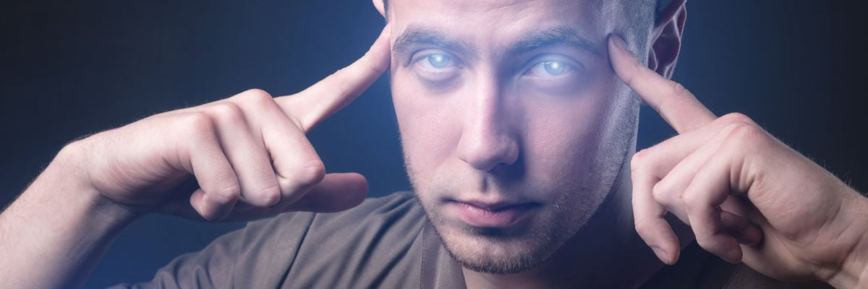
SPooky Bad Paranormal Studies
Eric Prebys
FRS-003-009

Slide 2
What is Paranormal?
The dictionary describes paranormal as
“denoting events or phenomena such as telekinesis or clairvoyance that are beyond the scope of normal scientific understanding.”
Specific examples include:
Clairvoyance, including
Remote viewing
Mind reading
Precognition
Psychometry (gaining information about objects by touching them)
Telekinesis: influencing a physical system without physical interaction.
Mediumship: acting as a bridge between the ”physical world” and the “spirit world”, including deceased people.
If these things do in fact exist, then we should be able to prove it and then try to explain them.

Slide 3

History of the “Paranormal”
The word was not coined in English until the early 20th century, but for most of human history, people would not have understood its meaning anyway.
From the dawn of history, people believed that our world was controlled by literal gods, demons, and magic.
They also believed that people could manipulate these things, through prayer, ceremony, sacrifice, incantation, etc.
For about the same amount of time, people have been performing illusions.
Either as entertainment or to fool people into thinking they had actual powers.
Modern stage magic started to appear in the 19th Century.
With the advent of the Enlightenment, people moved to explain more and more phenomena in terms of natural laws, while most still believed in “supernatural” things.
We’ll start our discussion with the rise of “spiritualism” in the 19th Century.

Slide 4
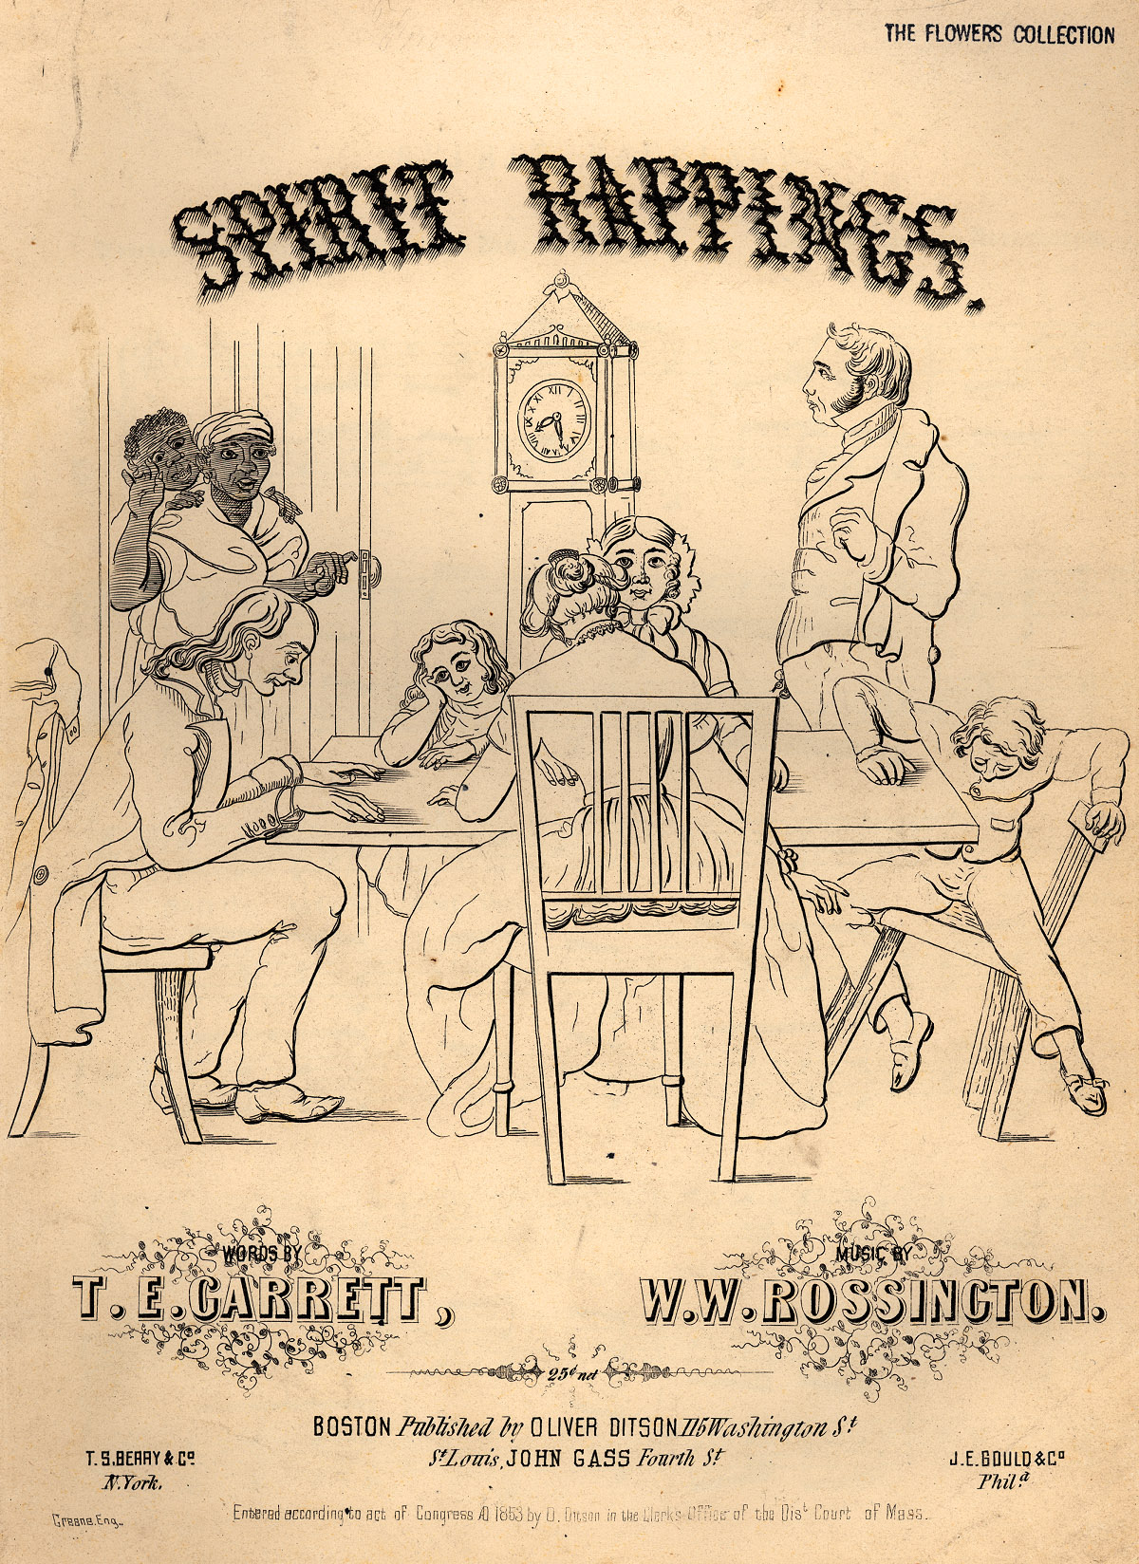
Spiritualism
As scientific knowledge grew, some people began to divide reality into the “natural” world and the “spiritual” world.
The spiritual world contained both non-human spirits AND the spirits of the deceased.
”Mediums” were people who claimed to communicate with this world – usually for a fee.
The ”spiritualism movement” grew in the 19th Century.
Paschal Beverly Randolph and Emma Hardinge Britten were two early “trance mediums” around 1950.
By the turn of the last century, medium-guided seances were very popular, particularly among the wealthy and educated in the English-speaking world.
The medium would go into a trance, make contact with the spirit world, often accompanied by sounds, lights, or the movement of objects in the room.
They would then speak or write for the spirits.

Slide 5
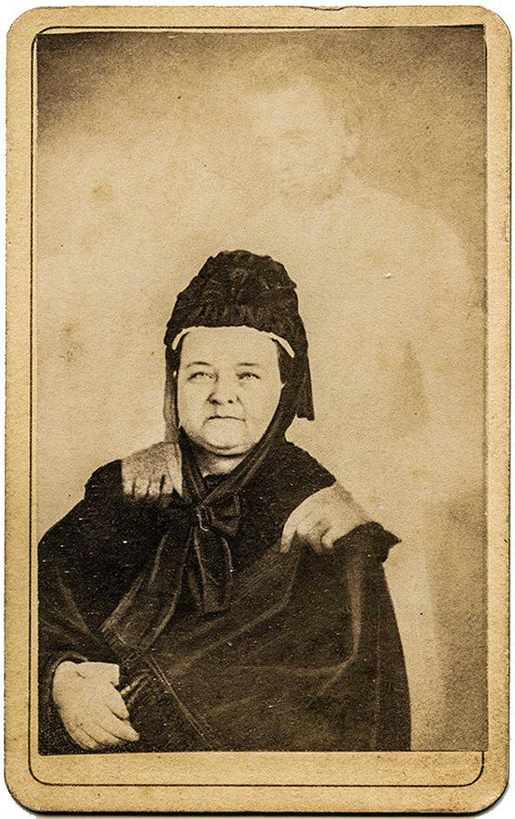
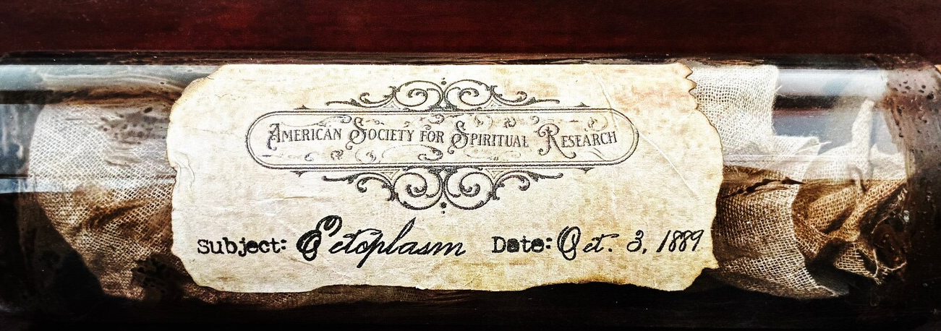
A Playground for Con Artists
As we’ll discuss, many people genuinely believe they have paranormal powers.
This was not the case with most mediums who used a whole host of tricks to separate their clients from their money*.
Among their tricks:
Using double exposure to create “spirit photography”
Levitation using cables and other devices.
Producing “ectoplasm” during seances.
This 1906 film exposes some of their tricks.
Mary Todd Lincoln and “her late husband”
*read “Spook: Science Tackles the Afterlife”, by Mary Roach

Slide 6
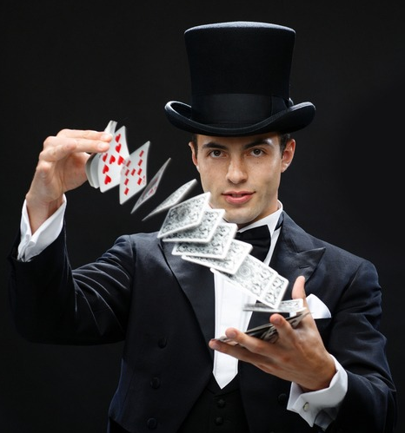
Enter Magicians…
As a group, scientists are pretty easy to fool.
Science works entirely on the honor system.
The peer review system is not charged, nor is it equipped, to find fraud.
If a scientist sees something that appears to challenge the laws of physics, the first question is “What’s the mistake?”
Magicians make a living through trickery
"Yes, indeed, I'm a trickster, I'm a cheat, I'm a charlatan, that's what I do for a living.” – James Randi
Their first question is, “What’s this trick?”
Most importantly, they understand that they too can be fooled, if they can’t fully control the scenario.
They’re also a little upset that people make money doing bad magic tricks by pretending they’re real!
This is why magicians have been some of the best debunkers for a very long time.

Slide 7
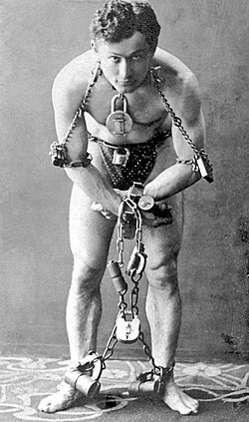
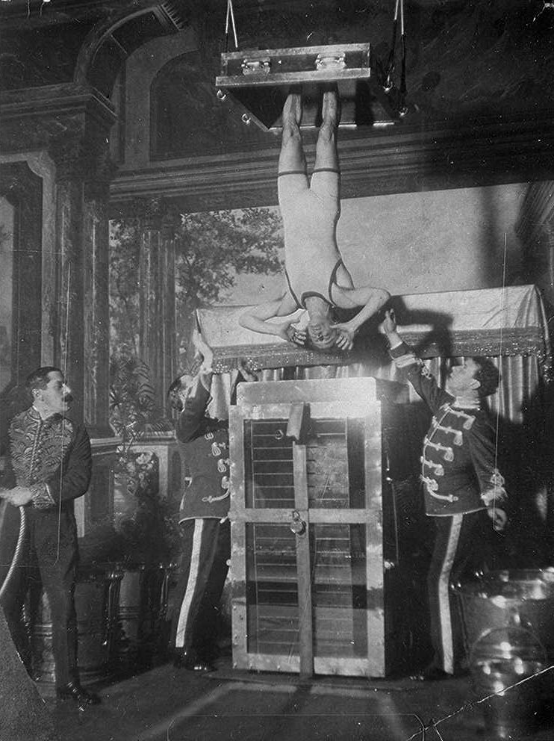
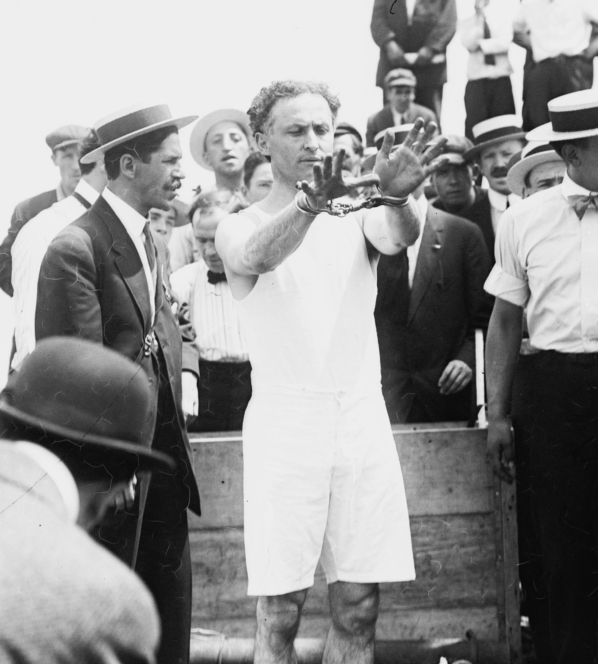
Harry Houdini: The OG Paranormal Debunker
Houdini was born Erik Weisz in Budapest Hungary in 1874, immigrating to the United States in 1878.
As a teenager, he began working as a magician, adopting the stage name “Harry Houdini” after a French magician he admired.
By most reports, he was a competent magician, but not noteworthy, so he soon turned his talents to performing escape acts, which made him world famous and quite wealthy.
His famous acts included the Chinese Water Torture Cell and the Overboard Box Escape.
He also had not very successful acting career.

Slide 8
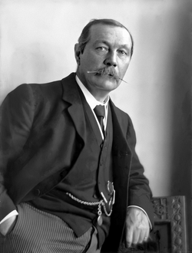
Houdini vs. Spiritualism
As a magician, Houdini saw spiritualists and mediums as simple frauds, and began challenging them in earnest in around 1920.
Among the people he exposed were:
George Valentine
Mina “Margery” Crandon
Joaquín Argamasilla (“The Spaniard with the X-ray Eyes”)
His close friend Arthur Conan Doyle (author of “Sherlock Holmes”) was a passionate believer in spiritualism, married to a self-proclaimed medium named Jean.
In 1922, Conan Doyle arranged for a séance, in which Jean contacted Houdini’s dead mother, to whom he’d been very close.
Jean wrote 15 pages as his mother.
Houdini declared them fake, based on the facts that
His “mother” put a cross at the top of the first page, in spite of the fact they were Jewish.
The pages were written in English, a language his mother could barely speak.
This ended his friendship with Conan Doyle.
Houdini became an inspiration to skeptics and debunkers to this day.
Arthur Conan Doyle

Slide 9
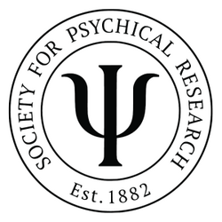
Paranormal Research
“Serious psychic research” began concurrently with the increased popularity of spiritualism.
One of the first societies dedicated to this research is the society for psychical research, established in London in 1882.
Originally, the organization did a lot of work exposing fraudulent psychics
This angered a lot of people, who left the organization, including Arthur Conan Doyle.
Later the group turned decidedly more pro-paranormal.
They still exist today
Including (paper!) magazine and journal
Appears to be mostly anecdotal and opinion pieces.
Other 19th Century paranormal research societies include
The American Society for Psychical Research (1884)
Association for the Scientific Study of Anomalous Phenomena (1881)
College of Psychic Studies (1884)

Slide 10
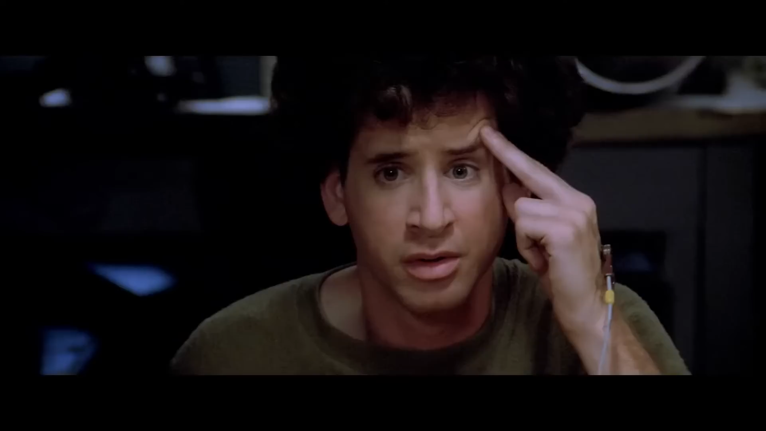
Psychic Research in Ghostbusters (1984)
Beyond the obvious, what are some things wrong with this protocol?

Slide 11
Extraordinary Claims Require Extraordinary Evidence
In examining psychic research, which continues to this day, it’s clear that researchers generally find its existence plausible.
They therefore use very low statistical significance to claim an effect.
A p-value of .05 is typically the threshold to claim an effect, just like medical research.
And we’ve already discussed how that’s much too low a threshold!
In contrast, when other scientists look to psychic research, they generally believe its existence as very unlikely, and therefore demand a much higher level of significance.
Personally, I view the demonstration of psychic phenomenon to be in the same class as violation of the conservation of energy.
Nothing less then a p-value of 10⁻³ should be reported, and it would take at least a p-value of 10⁻⁶ to truly establish that something paranormal exists.

Slide 12
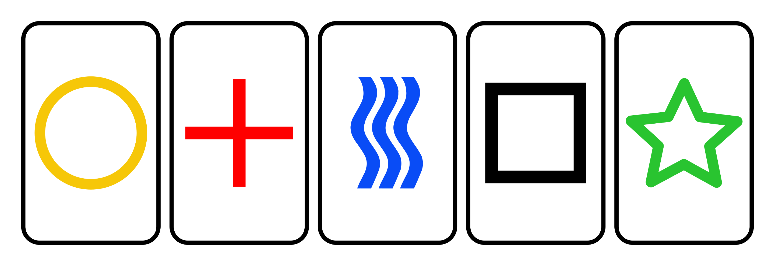
Example: Zener Cards
The cards in the Ghostbusters clip are called “Zener Cards”, and they’re a standard tool in psychic research.
The set consists of 5 cards.
In a remote viewing experiment, one person looks at a card, and another person tries to match it.
Doing it once has a p-value of .20
Doing it twice in a row has a p-value = (.20)² = .04 < .05 -> publishable!
Doing it nine times in a row has a p-value of (.20)⁹ = 5x10⁻⁷ < 10⁻⁶
If this were done in a truly controlled way, it would convince even the most hardened skeptics.
But what if psychic abilities aren’t perfect?
We can still statistically test them to this accuracy.

Slide 13
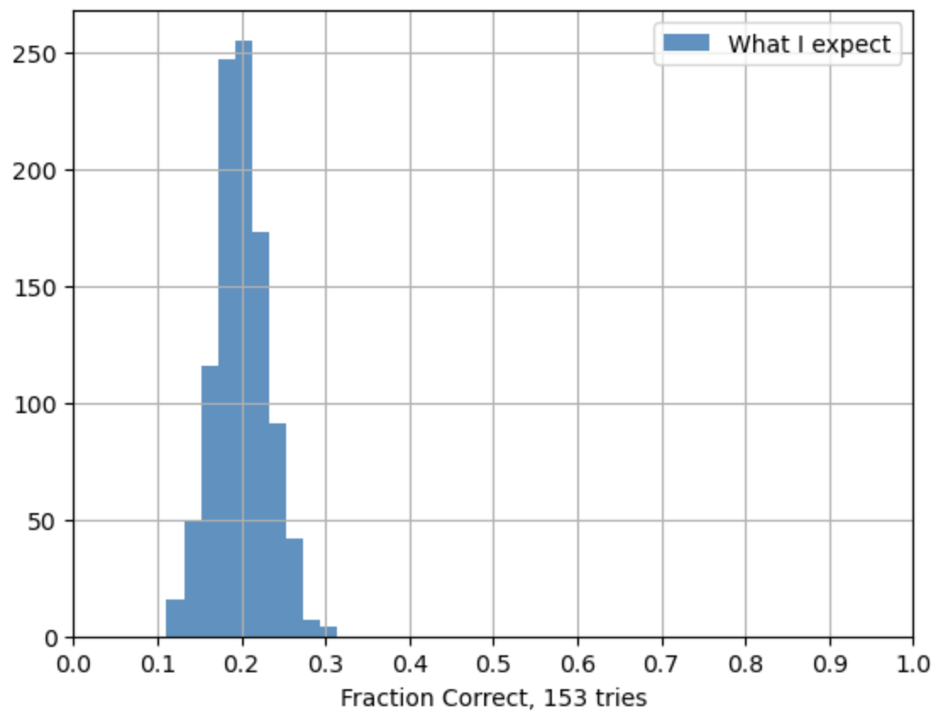

What if I get the right card a little more than chance?
Let’s say I can pick the right card 30% of the time rather than 20%
\
As far as I can tell, no one has ever attempted a remote viewing experiment to anywhere near this level of precision.
If I repeat the experiment 153 times and get 30% or more correct, I exclude statistical fluctuations with a p-value of 10⁻³
If I repeat the experiment 361 times and get 30% or more correct, I exclude statistical fluctuations with a p-value of 10⁻⁶

Slide 14
SRI International
In 1946, Stanford University created the “Stanford Research Institute”.
The institute focused on research that would benefit society at large. Some notable achievements
In 1968 (!), their Augmentation Research Center demonstrated hyperlinks, shared real time editing and the computer mouse.
Helped in the development of ARPANET, which eventually became the internet.
In the last 1940s, they early work in pollution research and was one of the first groups to raise the red flag about the deterioration of the ozone layer.
During the Vietnam War, many Stanford students and alumni protested the money the Institute was getting from Defense Advanced Research Projects Agency (DARPA)
As a result, the Institute formally separated from the university in 1970 and became SRI International.
In 1972, researchers Harold E. Puthoff and Russell Targ began a program into psychic phenomena
In 1995, we learned that these studies were arranged and funded by the CIA, as part of what soon became the Stargate Project*
*not to be confused with MKUltra, in which the CIA dosed people with LSD, often without their knowledge.

Slide 15
Why was the CIA Interested in Psychic Phenomena?
For the same reason we did EVERYTHING back then
Because we thought the Soviets were doing it!
In 1970, an intelligence report claimed that the Soviets were spending 60 million rubles (~$800k)/year on remote viewing studies.
We could not allow a psychic gap!
So research began at the CIA.
There were a couple of problems:
The CIA is terrible at doing science*.
Hal Puthoff and Russell Targ are…problematic.
When Puthoff wasn’t studying psychic phenomena he was pushing free energy schemes and communication schemes that violate the laws of physics.
Targ isn’t as crazy as Puthoff, just very sloppy.
The studies done at SRI could not be called rigorous.
*e.g. “Operation Midnight Climax”

Slide 16
Stargate Project
In 1977, the research started at SRI and other clandestine research projects were absorbed into an Army unit called the Stargate Project .
The focus was on remote viewing as a weapon against the Soviets.
Key players in the program were
Joseph McMoneagle, an Army Chief Warrant officer, known for numerous and contradictory claims about the paranormal
Albert Stubblebine, an Army Major General who called himself a “psychic headhunter” and felt that psychic warfare should be a major thrust in the US military. Later went on to support many conspiracy theories.
Very colorful stories about these two and others can be found in the book “The Men who Stare at Goats”*, by Jon Ronson (although he doesn’t mention Stargate by name).
The project claimed some successes
Most notably, in 1976, they claim Rosemary Smith was able to find a downed Soviet spy plane in Zaire (now the Democratic Republic of Congo), but there are no details or supporting documentation.
We’ll return to the Stargate Project later.
*This was the inspiration for an entertaining but highly fictionalized movie of the same name.

Slide 17
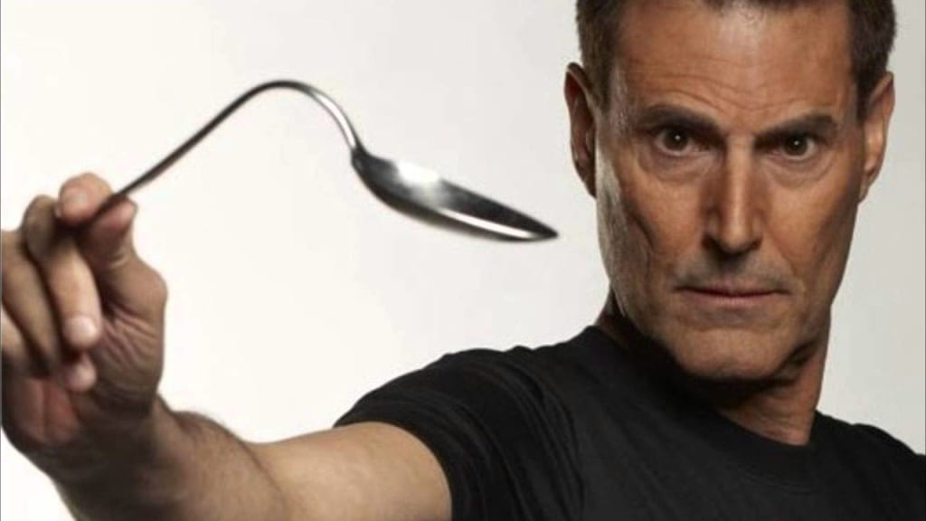
Uri Geller
Uri Geller was born in Tel Aviv in 1946
His family moved to Cyprus and in the late 1960s, he began to perform magic tricks.
He soon became very famous in Israel and by the early 1970s, he was becoming well known in the US
His most common trick involved bending spoons “with his mind”. Other tricks included:
Remote viewing
Telekinesis
Dowsing
As magic tricks, all of these things were unimpressive, but he claimed they were real.
People all over the world believed him without question.
You can find instructions on how to do his spoon bending trick here and his spoon breaking trick here.
In 1973, he was tested by the CIA at SRI and convinced them he was real.
He was generally considered their biggest success.

Slide 18
SRI Research on Uri Geller
Their research was published in Nature(!) in 1974.
The tests published involved putting Geller in a sealed room, and having him receive ”remote viewing” images from other people.
The test protocols in the paper are bizarre.
Rather than focus on one type of tests, they do several different things during 11 tests over 8 days.
Sometimes the sender was in a nearby room, sometimes across the country.
In one case they used primitive computer graphics to make the picture and in another they stored it in computer memory.
There are lots of details about somethings and no details about others, like how long each test took.
In particular, only 11 tests in 8 days doesn’t sound like very many.
How much were they leaving out?

Slide 19
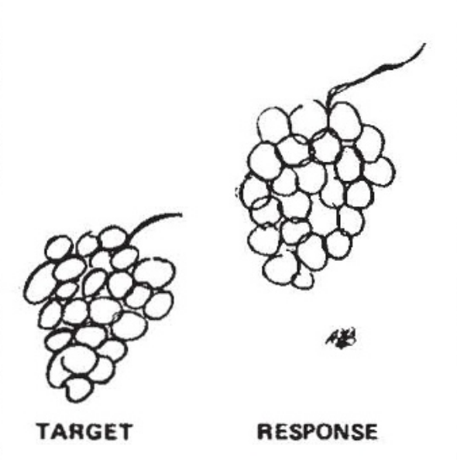
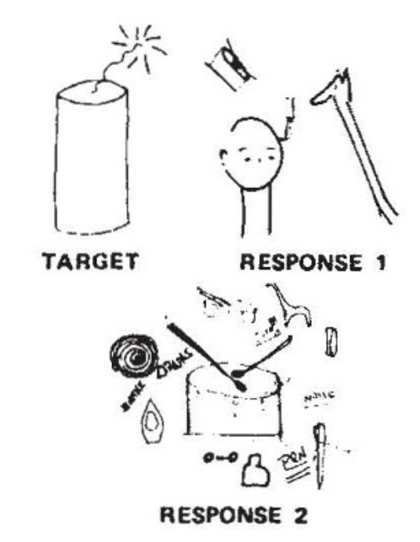
Results of the Tests
Sometimes the results were remarkable?
Sometimes much less so
Response 2 was counted as a “hit” because a drum is round and makes noise.

Slide 20
Ray Hyman’s Analysis of Geller
Ray Hyman is a professor of Psychology at U of Oregon.
Also a long time skeptic
He was asked by DARP to evaluate Geller.
He also looked into the tests done at SRI, and concluded that – contrary to the claims of Putoff and Targ – Geller had many opportunities to gain knowledge about the target images.
His conclusion was that Uri Geller was a complete fraud.
We’ll be hearing more from Dr. Hyman later.

Slide 21

Uri Geller on Johnny Carson
Geller had been on MANY news and talk shows, and he always did impressive things
In 1973, he appeared on Johnny Carson, and things didn’t go so well

Slide 22
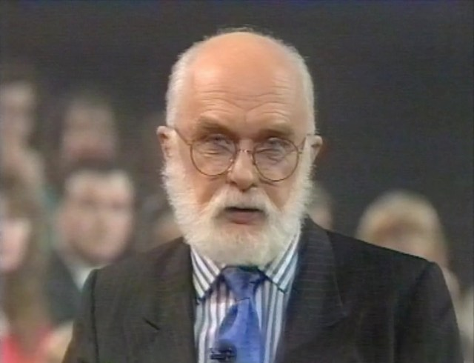
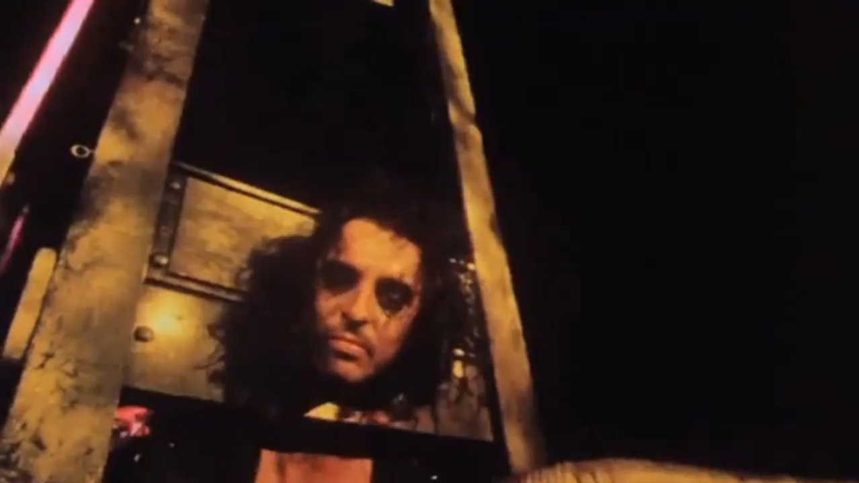
James Randi: Modern Houdini
James Randi was a successful magician, escape artist, and part time actor.
One of his more colorful achievements was touring with the Alice Cooper band in 1973 to manage an on-stage beheading illusion.
He was always interested in exposing frauds
As a teenager, he exposed a “mind reading” preacher.
In the 1970s, he transitioned to investigating the paranormal full time.
First big success was the Geller’s Johnny Carson appearance.
If you recall, he also debunked homeopathy data in the 1980s
In 1989, he was the first (only?) non-scientist to win the APS Forum Award for “promoting public understanding of the relation of physics to society”.
Eventually established the James Randi Educational Foundation (JREF, more about that soon)
I highly recommend the documentary “An Honest Liar”, about his life.

Slide 23
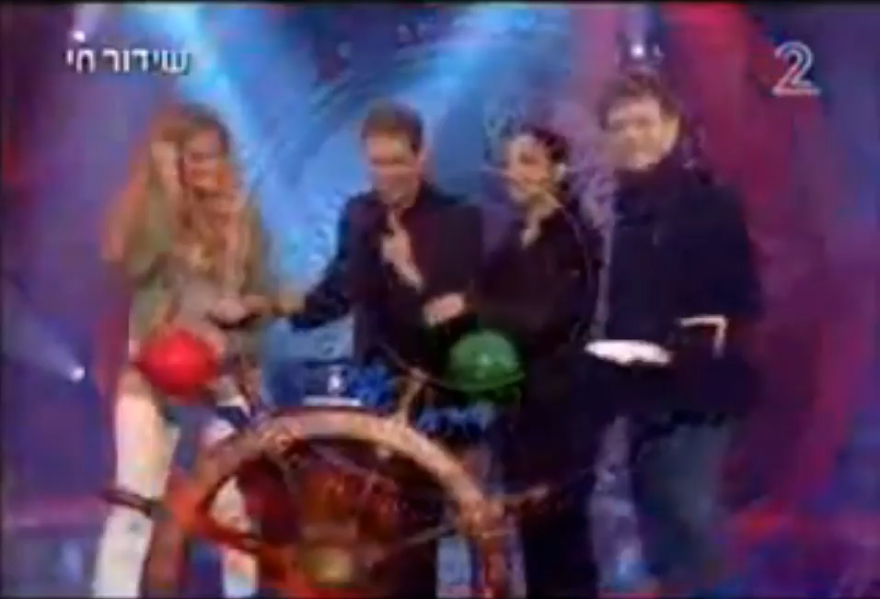
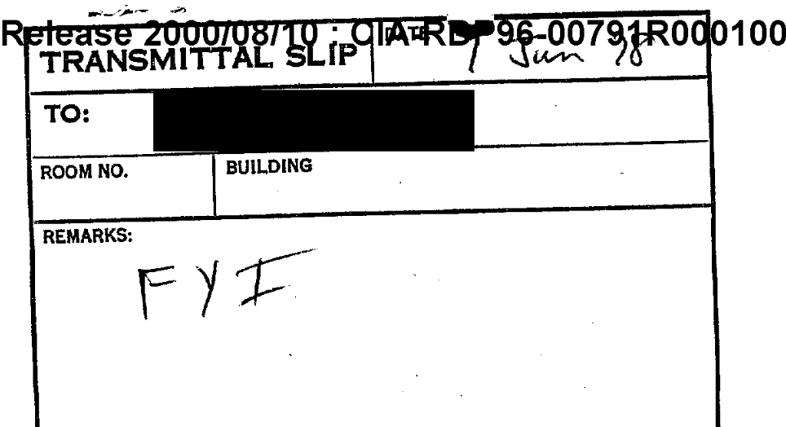
Uri Geller’s Career
Uri Geller’s Career was completely unaffected by his exposure on the Johnny Carson show.
He spent many years trying unsuccessfully to sue James Randi for calling him a fraud.
In 2006-7 he had a TV show in Israel called ”The Successor”, where he was again caught cheating.
Full clip here.
Geller continues to claim his “powers” are genuine and has never admitted that he’s merely an illusionist.
In 1978, Geller’s former manager, Yasha Katz, admitted that Geller was just using illusions and explained how many of the tricks were done.
Interestingly, the only place I could find the original article was a declassified CIA copy with the cover note “FYI”.

Slide 24
The End of Stargate
In 1995, the CIA charged the American Institutes for Research to evaluate the program.
They commissioned a “blue ribbon panel”, headed by
Prof. Jessica Utts, a UC Davis (!) Statistics Professor (now emeritus at Irvine), who had published research supporting psychic phenomena.
Prof. Ray Hyman, a Professor of Psychology at U of Oregon Eugene. Known to be very skeptical of psychic phenomena, he had previously strongly criticized their conclusions on Uri Geller.
In spite of the claims about the downed spy plane, the review concluded that
“no remote viewing report ever provided actionable information for any intelligence operation.”
Their report concluded:
The foregoing observations provide a compelling argument against continuation of the program within the intelligence community. Even though a statistically significant effect has been observed in the laboratory, it remains unclear whether the existence of a paranormal phenomenon, remote viewing, has been demonstrated. […] Most importantly, the information provided by remote viewing is vague and ambiguous, making it difficult, if not impossible, for the technique to yield information of sufficient quality and accuracy of information for actionable intelligence. Thus, we conclude that continued use of remote viewing in intelligence gathering operations is not warranted.
As a result of this review, the program was terminated.

Slide 25
One Million Dollar Paranormal Challenge
James Randi had a long history of offering rewards to anyone who could demonstrate paranormal phenomena in controlled conditions
In 1964 he offered $1000, which he increase to $10,000
Later, Lexington Broadcasting added $90,000 to do a show called “The $100,000 psychic prize”
In 1996, Randi started the James Randi Educational Foundation (JREF).
This is a grant-making institution to investigate claims of the paranormal.
The same year, internet pioneer Rick Adams donated $1 million to be used as a prize for anyone who can successfully demonstrate a paranormal phenomena under controlled conditions.
Rules:
JREF and the applicant must agree in advance as to the details of the test and what will constitute “success”
The odds of success due to chance alone must be very low, on the order of 1 in a million.
Since he started offering rewards, over 1,000 people have applied to be tested.
None succeeded.
The challenge was formally terminated in 2015 to free up the money for other uses.

Slide 26
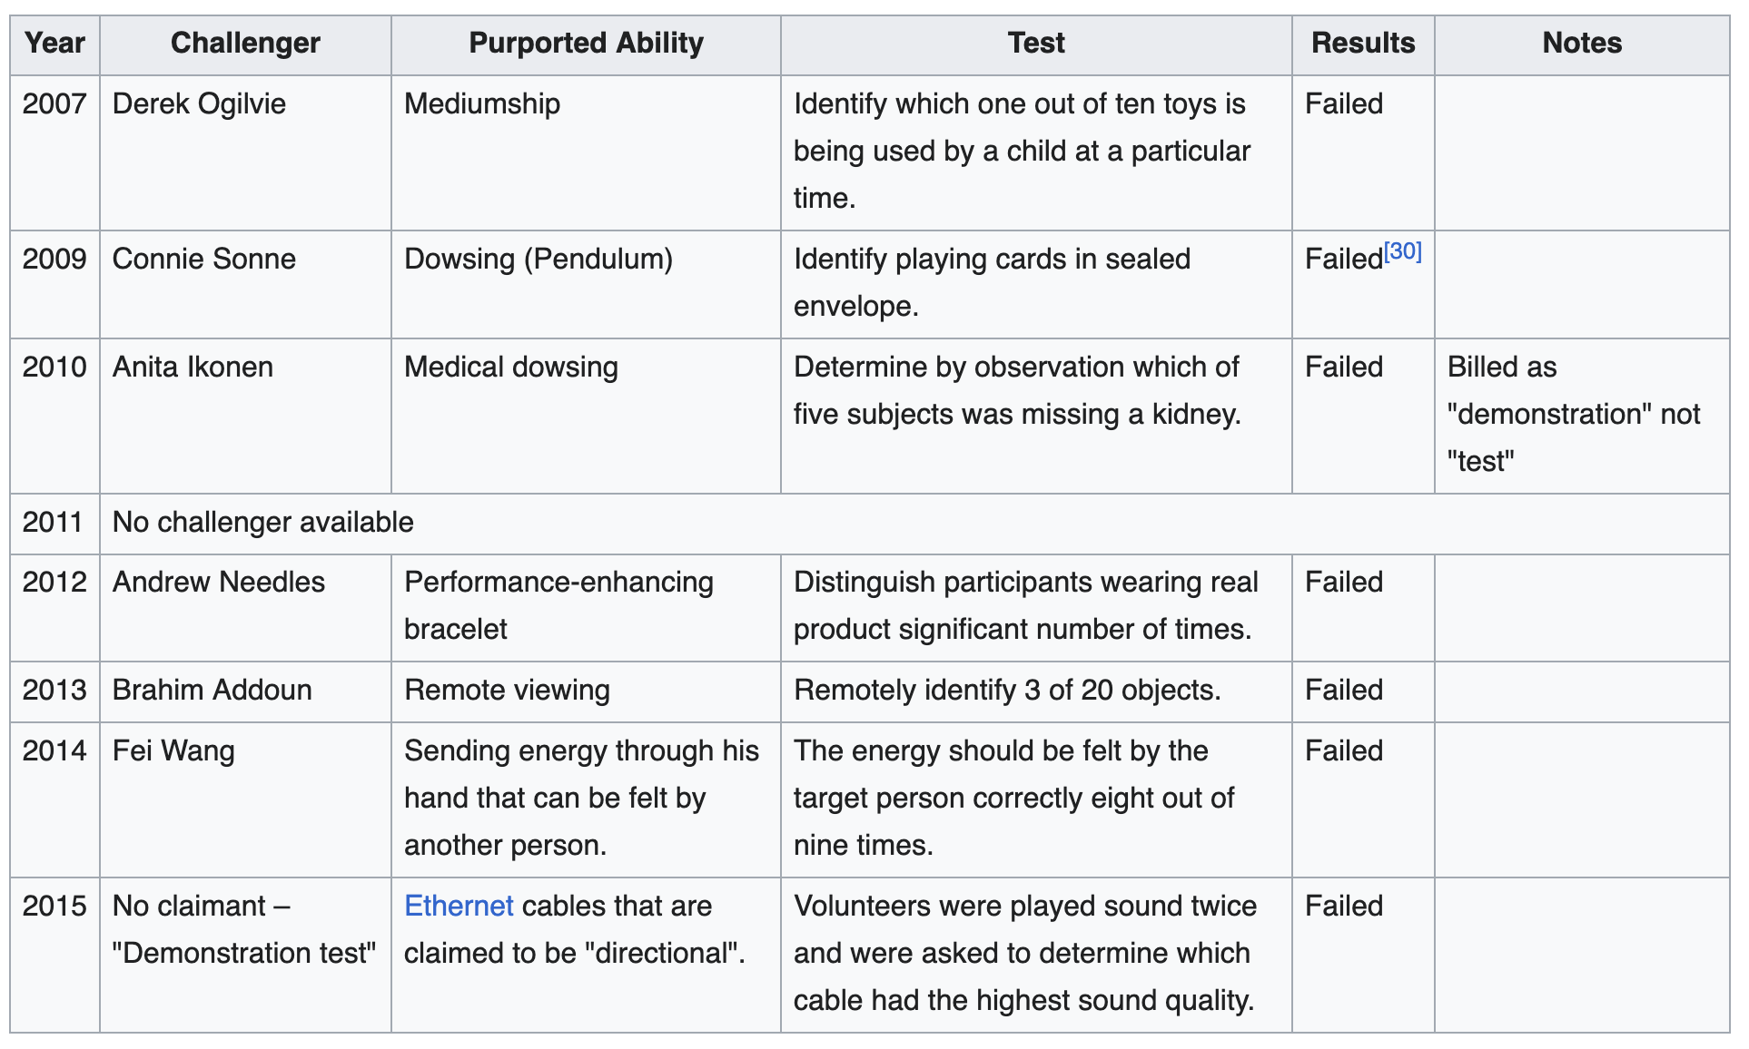
Tests at The Amazing Meeting (skeptic conference)
Unfortunately, details of JREF testing and correspondence are no longer public; however, they sometimes took challengers at the Amazing Meeting

Slide 27
Some Notable Refusals
Notably, Randi’s nemesis Uri Geller never volunteered to be tested.
In 2001, famous psychic Silvia Browne agreed on Larry King Live to take the challenge, but then never did.
Browne was a thoroughly loathsome individual who proved there’s no such thing as “harmless nonsense”.
She often claimed to work with police to solve cases (she hadn’t)
In one famous case, she told Louwanna Miller that her missing daughter, Amanda Berry, was “not alive”.
Amanda Miller was in fact being held captive by Ariel Castro.
In her final failure, she predicted she herself would die at 88, but died at 77.
In 2007, Randi challenged psychic Rosemary Altea to take the one-million-dollar challenge. She refused.
In 2011, magician Paul Zenon challenged Welsh psychic Leigh Catherine (aka Leigh-Catherine Salway) to take the one million dollar challenge and she accepted.
She later backed out.

Slide 28
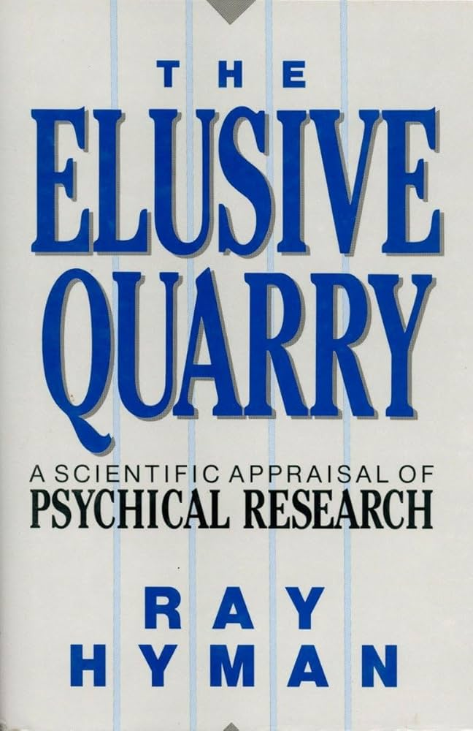
Detailed Studies of Psychic Research
There have continued to be paranormal studies since the glory days of the 1970s.
My impression is that these are done by sincere researchers who are trying to use proper controls.
The best summary I’ve found is The Elusive Quarry, by Ray Hyman
If you recall, he was one of the people responsible for shutting down Project Stargate.
It’s a thorough review of the body of psychic research considered the most convincing.
Not the most engaging reading material though.

Slide 29
The Book’s Conclusions
He begins by looking at “Ganzfield Experiments”; that is, experiments wherein a “sender” sends an image to a receiver.
These usually involve the Zener Cards, we discussed earlier
He settled on 42 studies that were considered the gold standard.
Among the problems he called out:
Problems with randomization.
Problems with what constituted a “hit”
Sometimes it was exact match
Sometimes it was being in the top two choices
Not clear if this was decided after the fact.
Possible problems with “data leakage”; i.e. testers influencing the people being tested.
Poor statistical analysis. His conclusion is that the p-value is often much higher then .05
His conclusion is that the body of research does NOT establish the existence of psychic abilities to a statistically significant level.

Slide 30
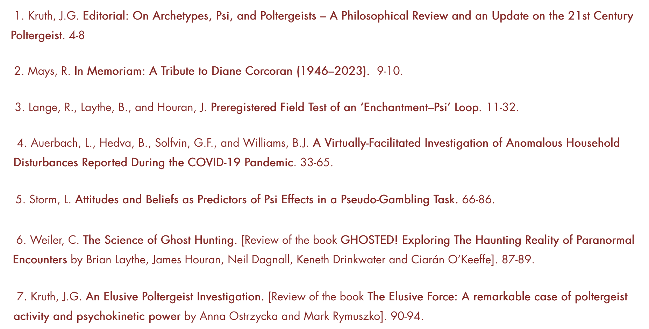
Psychic Research Today
There is still a good deal of paranormal research going on.
The premiere peer-reviewed journal is The Journal of Parapsychology, founded in 1937. Now open access.
Table of contents of a recent journal

Slide 31
Overview of Paranormal Research
The community has been “seriously” studying paranormal phenomena for roughly 140 years now.
Each generation of researchers acknowledges problems with previous research and works to rectify them.
Even so, after all this time, we have not had a single, reproducible, high significance result under properly controlled conditions.
We’re reminded yet again of Bob Parks warning sign #3
An effect is always at the very limit of detection.
Personally, I would love for paranormal phenomena to be real.
I just don’t believe they are.

